Slide 1
VAC 25
Value-driven leadership

Slide 2
COURSE SYLLABUS
Unit 1: Introduction and Resolving Conflicts of Values within and between other Stakeholders
Introduction to Concepts like Morals, Values, Ethics, Trust, Integrity, Justice, Fairness, Community, Civility and Community, Conflicts, and Stakeholders. Issues of Conflicts. Resolving Conflicts of Values within and between other Stakeholders.
Unit 2: Workforce Diversity and Corporate Social Responsibility
Diversity, Types of Diversity, Benefits of Workforce Diversity. Corporate Social Responsibility. Milton Friedman's Approach, Companies Act and Corporate Social Responsibility
Unit 3: Managing Values through Incentives and Informal Mechanisms
Managing Values, Incentives, Material Incentives, Informal Mechanisms, Managing Values through Incentives and Informal Mechanisms
Unit 4: Speaking the Truth and Values Based Marketing
Truth, Unethical Behaviour, Situations where Truth is dangerous for the organization, Importance of Speaking the Truth. Ethical implications of Marketing Values, Importance of Values Based Marketing. Thomas Donaldson's Ethical Algorithm
Unit 5: Building Social Capital
Social Capital, Constituents of Social Capital, Importance of Social Capital for an Organization, Use Organizational Intellectual Capital to Create Value

Slide 3
UNIT 2

Slide 4
WORKPLACE DIVERSITY
Workplace diversity means respecting and valuing the ` and differences that each staff member brings into the workspace.
A diverse workplace is an inclusive environment that provides equal rights and opportunities for all workers, regardless of gender, colour, age, ethnicity, physical ability, sexual orientation, religious beliefs, and so on.
It is the law in several countries for workplaces to provide equal opportunity to their employees, as well as to create a workplace free from discrimination and harassment.
Employers are responsible for putting measures into place to overcome employment disadvantage and discrimination in the workplace. This includes valuing workplace diversity and ensuring that a workplace is free from racial and sexual harassment, discrimination, and bullying.
Workplace diversity was one of the key workplace trends in 2020. With the pandemic caused by Covid-19, companies have turned to the global workforce and started hiring more and more diverse teams while working remotely.

Slide 5
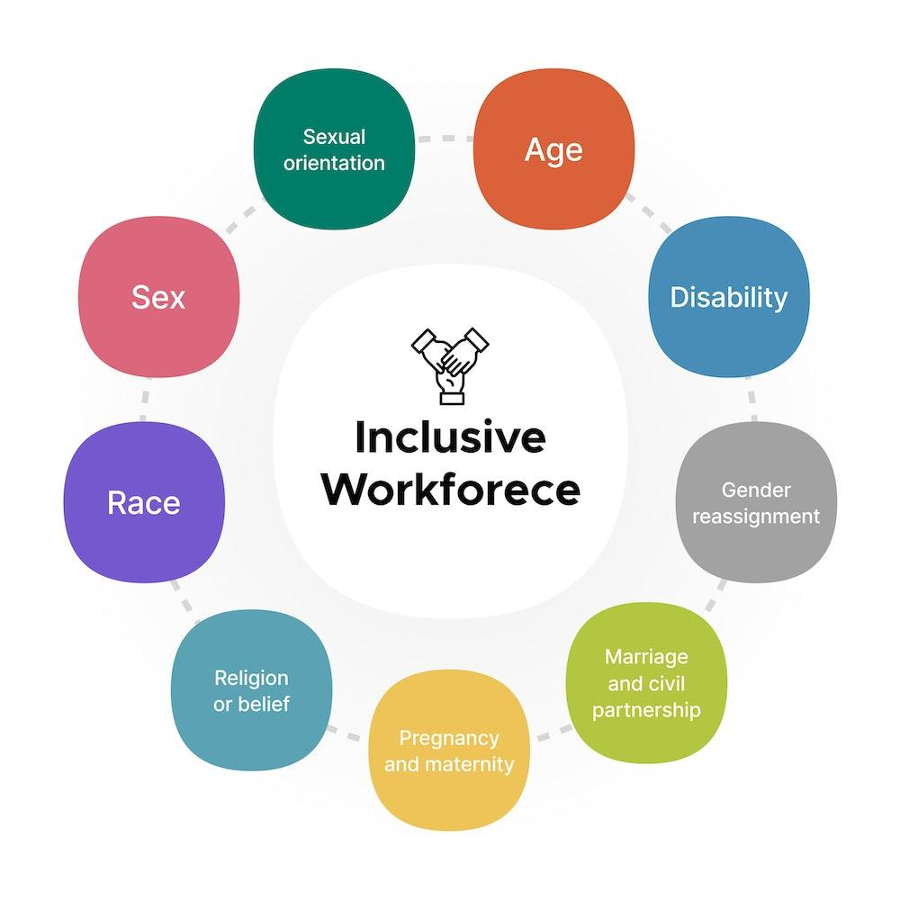


Slide 6
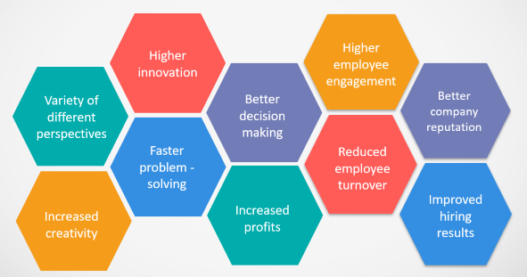
BENEFITS
Having a diverse and multicultural workplace brings several advantages. Since today’s world is increasingly more globalised and interconnected, workplaces should take advantage of the diverse range of skills individuals from different backgrounds and languages can bring.

Slide 7
Variety of different perspectives
Increased creativity
Diversity in the workplace ensures a variety of different perspectives.
Since it means that employees will have different characteristics and backgrounds, they are also more likely to have a variety of different skills and experiences.
Consequently, employees in a company with higher workplace diversity will have access to a variety of different perspectives, which is highly beneficial when it comes to planning and executing a business strategy.
A diverse range of cultures within the workplace allows companies to deal with the different nuances within a global marketplace.
For example - if a company does business with China, for example, having an employee who can speak Mandarin is an asset and can lead to improved workplace relations.
Higher innovation
Faster problem solving
Better decision making
Increased profits
Higher employee engagement
Reduced employee turnover
Better company reputation
Increased productivity

Slide 8
Variety of different perspectives
Increased creativity
In addition to having a variety of different perspectives from people with different backgrounds, the exposure to a such variety leads to increased creativity.
A diverse workforce brings together people from different cultural backgrounds with different ways of thinking and approaching problems. This can lead to a wider range of perspectives, which in turn can lead to more innovative and creative solutions.
When you put together people who see the same thing in different ways, you are more likely to get a melting pot of fresh, new ideas, thus improving the creativity of your workforce.
As various cultures and backgrounds work together, the opportunity for increased creativity exists. This is because there are more people with differing perspectives and solutions to problems, allowing for a greater chance of a workable solution to a workplace problem.
Higher innovation
Faster problem solving
Better decision making
Increased profits
Higher employee engagement
Reduced employee turnover
Better company reputation
Increased productivity

Slide 9
Variety of different perspectives
Increased creativity
Diversity in the workplace leads to higher innovation rate.
People from different backgrounds can draw upon their unique experiences and knowledge to spark new ideas.
Diversity can stimulate innovation by challenging conventional thinking, encouraging fresh ideas and promoting creative problem-solving.
Diverse and inclusive teams create an environment where people can be themselves without judgment. They're more likely to take risks and share new ideas when that happens.
Having diverse perspectives from teammates who come from different backgrounds ensures that problems are approached from multiple angles and this can lead to faster resolutions.
Higher innovation
Faster problem solving
Better decision making
Increased profits
Higher employee engagement
Reduced employee turnover
Better company reputation
Increased productivity

Slide 10
Variety of different perspectives
Increased creativity
Companies with higher workplace diversity solve problems faster.
The range of experience, expertise, and working methods that a diverse workplace offers can boost problem-solving capacity and lead to greater productivity.
A high degree of cognitive diversity could generate accelerated learning and performance in the face of new, uncertain, and complex situations, enabled by diverse teams which are able to solve problems faster than cognitively similar people.
Employees from diverse backgrounds have different experiences and views, which is why they are able to will bring diverse solutions to the table. Thus, the best solution can be chosen sooner, which leads to faster problem-solving.
Higher innovation
Faster problem solving
Better decision making
Increased profits
Higher employee engagement
Reduced employee turnover
Better company reputation
Increased productivity

Slide 11
Variety of different perspectives
Increased creativity
According to Forbes, decision making improves as team diversity increases. A study by People Management found that diverse teams (of three or more people) outperformed individual decision-makers up to 87% of the time.
A diverse workplace brings together a variety of ideas and perspectives, which can lead to innovation and creativity.
This reduces groupthink, as a diverse group of people may be more comfortable offering new ideas and questioning the ideas of others.
A diverse team allows for a wide range of experiences and backgrounds, which can lead to a broader set of ideas. Multiple diverse perspectives can enhance both the understanding of the problem and the quality of the solution.
Individuals are more likely to consider more alternatives and think outside the box when making decisions.
Higher innovation
Faster problem solving
Better decision making
Increased profits
Higher employee engagement
Reduced employee turnover
Better company reputation
Increased productivity

Slide 12
Variety of different perspectives
Increased creativity
A diverse workforce improves risk management, extends market prospects, fosters innovation and creativity, and increases employee performance and engagement
A diverse staff can help businesses reach a wider customer base. Customers feel understood and valued, and a diverse team is more likely to achieve that.
Companies with a diverse workforce make better decisions faster, which gives them an advantage over their competitors.
A diverse workplace can lead to increased productivity. This is because a diverse workforce brings a broader range of skills, experiences, and perspectives to the table.
McKinsey & Company, in a research on 180 companies in France, Germany, the United Kingdom, and the United States, found that companies with diverse leadership were top financial performers.
Higher innovation
Faster problem solving
Better decision making
Increased profits
Higher employee engagement
Reduced employee turnover
Better company reputation
Increased productivity

Slide 13
Variety of different perspectives
Increased creativity
Workplaces that are perceived as diverse have the highest levels of employee engagement. Engaged employees are more productive, profitable, safer, and stay longer with their company.
Diversity increases employee satisfaction and reduces conflicts between groups.
Diversity is an emerging talent retention strategy. Employees are more committed and inclined to work for an organization longer when their unique contributions are recognized and acknowledged.
Other elements include: Reduced employee stress, Decreased burnout, Improved collaboration, and Lower absenteeism.
The link between workplace diversity and employee engagement is pretty straightforward - when employees feel included, they are more engaged.
Higher innovation
Faster problem solving
Better decision making
Increased profits
Higher employee engagement
Reduced employee turnover
Better company reputation
Increased productivity

Slide 14
Variety of different perspectives
Increased creativity
Workplace diversity is beneficial for employee retention.
Companies with a diverse workforce are generally more inclusive of different individual characteristics and perspectives.
Diversity and inclusion in the workplace cause all employees to feel accepted and valued.
When employees feel accepted and valued, they are also happier in their workplace and stay longer with a company.
As a result, companies with greater diversity in the workplace have lower turnover rates. By creating commitment to diversity and employees create a sense of belonging to the company and are less likely to leave.
Higher innovation
Faster problem solving
Better decision making
Increased profits
Higher employee engagement
Reduced employee turnover
Better company reputation
Increased productivity

Slide 15
Variety of different perspectives
Increased creativity
Companies that are dedicated to building and promoting diversity in the workplace are seen as good, more human and socially responsible organizations which ultimately creates a better reputation for the brand.
Workplace diversity also makes your company look more interesting. Finally, if you present a diverse workforce, you will make it easier for many different people to relate to your company and your brand, opening doors to new markets, customers and business partners.
Companies that have a diverse workplace are often perceived as better employers. Potential employees want an employer who accepts and is tolerant of all backgrounds and who treats their employees fairly.
Higher innovation
Faster problem solving
Better decision making
Increased profits
Higher employee engagement
Reduced employee turnover
Better company reputation
Increased productivity

Slide 16
Variety of different perspectives
Increased creativity
A diverse workplace allows for more ideas and processes. This diversity of talent means a broader range of skills among employees, as well as a diversity of experiences and perspectives which increases the potential for increased productivity.
This is also enabled by increased marketing opportunities: If potential employees or customers see that a company represents a diverse workplace, it makes them feel like they can relate to the company more. Using advertising that depicts mature-aged, differently-abled, or ethnically diverse people encourages applicants to apply, promotes a positive reputation, increases marketplace awareness, and generates a more diverse client-base.
Achieving workplace diversity means you are bringing out the very best of your employees and allowing them to reach their full potential. By doing so, your workplace benefits as it encourages a more varied and innovative talent pool.
Higher innovation
Faster problem solving
Better decision making
Increased profits
Higher employee engagement
Reduced employee turnover
Better company reputation
Increased productivity

Slide 17
Outsourcing to freelancers
Preventing sexual harassment
Recruiting millennial talent
7 Key Workplace Trends
Automation of redundant tasks
Enhanced work-life balance
Flexible hours and workspace
More diversity & inclusion

Slide 18

TIPS TO CREATE A DIVERSE WORKPLACE
Discuss diversity with your employees and outline the benefits of a diverse workplace.
Identify and address any bias when it comes to the recruitment process. Have hiring managers be aware of the qualities and benefits applicants of varying backgrounds can bring to the company and ensure they are allowing for a fair hiring process. Let applicants know that you are an equal-rights employer.
Value the individual skills that employees bring and make sure to utilize these strengths to help broaden your market and grow your company.
Allow for flexible work options and provide the opportunity for parental leave for both women and men.
Create and implement a Workplace Diversity Plan for employees to become familiar with to practise diversity and inclusiveness within the workplace.

Slide 19
CORPORATE SOCIAL RESPONSIBILITY (CSR)
Corporate Social Responsibility (CSR) implies a concept, whereby companies decide voluntarily to contribute to a better society and a cleaner environment – a concept, whereby the companies integrate social and other useful concerns in their business operations for the betterment of their stakeholders and society in general in a voluntary way.
However, Section 135 of the Companies Act, 2013 ("Act") provides that certain companies must mandatorily contribute a certain amount towards CSR activities. As per the Act, 'Corporate Social Responsibility' means and includes but is not limited to:
  • Projects or programs relating to activities specified in Schedule VII to The Act.
• Projects or programs relating to those activities which are undertaken by the Board of Directors of a company in ensuring the recommendation of the CSR Committee of the Board as per declared CSR Policy along with the conditions that such policy will cover subjects specified in Schedule VII of the Act.

Slide 20

IMPORTANCE OF CSR
CSR is an immense term that is used to explain the efforts of a company in order to improve society in a significant manner. Below reasons reflect why CSR is important:
CSR improves the public image by publicising the efforts towards a better society and increasing their chance of becoming favourable in the eyes of consumers.
CSR increases media coverage as media visibility throws a positive light on the organisation.
CSR enhances the company’s brand value by building a socially strong relationship with customers.
CSR helps companies to stand out from the competition when companies are involved in any kind of community.

Slide 21

CSR APPLICABILITY IN INDIA
According to Companies Act, 2013(Section 135 (1)) , the provisions of CSR apply to every company fulfilling any of the following conditions in the preceding financial year:
• Net worth of more than Rs.500 crore
• Turnover of more than Rs.1000 crore
• Net profit of more than Rs.5 crore
The Board of Directors of every company for which the CSR provisions apply must ensure that the company spends in every financial year at least 2% of its average net profits made during the immediately preceding three financial years as per its CSR policy. If the company has not completed three financial years since its incorporation, it must spend 2% of its average net profits made during the immediately preceding financial years as per its CSR policy.

Slide 22


Slide 23
The Friedman Doctrine, developed by American Economist Milton Friedman, is a theory of business ethics that states that “an entity’s greatest responsibility lies in the satisfaction of the shareholders.” Therefore, the business should always endeavor to maximize its revenues to increase returns for the shareholders.
An entity does not have any social responsibility to the society around it whatsoever. Instead, he stated that the only responsibility that an entity should abide by is its shareholders.
Friedman justified his claim by explaining that any executives in business are employees of the owners, and they are, therefore, required to deliver quality service to the employer first before any other party.
Profits maximization requires the entity to find ways of generating additional revenues through value addition and creating more products and services while minimizing costs.
Friedman also stated that shareholders should be in charge of key decisions such as social initiatives rather than getting an outsider to make the decision on their behalf.

Slide 24
Friedman’s approach to CSR is also called the shareholder approach of CSR.
Friedman suggests that profits seeking firms, just as any private agent, do not have sufficient incentives to efficiently internalize the costs they cause and thus could not be expected to act socially or environmentally responsible. Consequently, although being a “market purist”, he advocates government intervention, through regulation or taxation, based on public preferences (not managers’) and democratic empowerment (not contractual).
For Friedman, businessmen who believe that a business needs to have a “social conscience” are just “unwitting puppets of the intellectual forces”, mining the foundation of a free society.
There are two approaches to Friedman’s opinions on CSR –
    Utilitarian approach
    Deontological approach

Slide 25
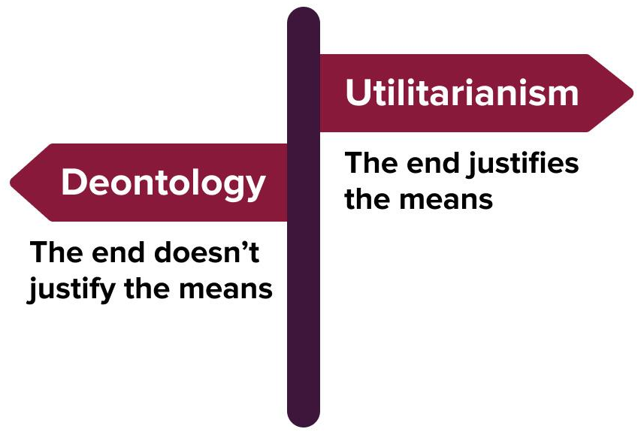
The utilitarian argument focuses on the concept of self-interest.
Friedman believes that market participants, by pursuing their own egoistic self-interests (seeking profits), are guided by an “invisible hand”, and unintentionally benefit society as a whole in a more efficient way (Pareto Optimality) than when they would by acting directly to promote the public welfare.
Put differently, Friedman questions the competence of business leaders to discern and directly promote the general welfare and concludes that “the market itself is the best mechanism by which to promote the public good”.
Therefore, there is no justification to make a claim that “businesses have any social responsibilities other than to legally and honestly maximize the profits of the firm”

Slide 26
The deontological argument, instead, gravitates around the observation that businesses are contractual arrangements between stockholders and executives.
As such, managers’ “primary responsibility is to them”: executives must not divert business resources away from the purposes expressly authorized by the stockholders, irrespective of any societal benefits that could be accrued by doing so.
They are always free, as private citizens, to spend their own personal funds for charitable or socially beneficial projects, but, when functioning as agents of the stockholders, if they engage in actions that are unrelated to profits maximization, they not only violate their fiduciary duties, but also become in effect “public employees” or “civil servants”, imposing taxes on business owners and promoting an “unadulterated socialism”.
In other words, in the shareholder perspective of Friedman, CSR can be just explained as a manifestation of moral hazard towards owners.

Slide 27
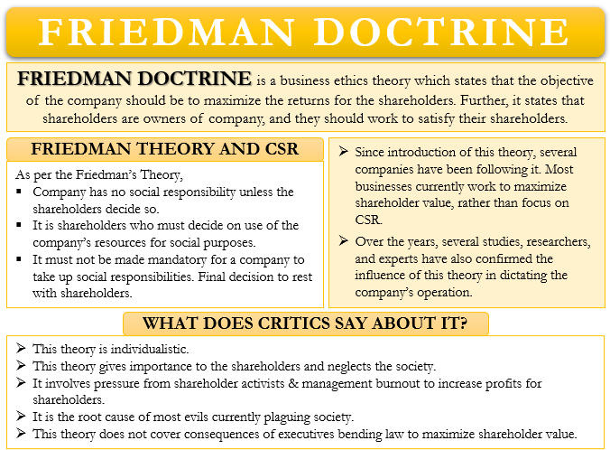
S
U
M
M
A
R
Y

Slide 28

THANK
YOU

